Slide 1
Transmaterial Worlding as Ecorelational Practice
Dr Leah Salter
Systemic In Nature
Rookhow, Lake District October 2025

Slide 2
A bit about me/ my influences…
Practice Contexts:
Centre for Systemic Studies (learning as social/ relational)
CTMUHB (Community, adult mental health/ parental wellbeing/ narrative approaches/ S4H)
Centre for Storytelling/ USW
University of Bedfordshire
Cardiff University
Murmurations Journal of Transformative Systemic Practice
Other: Health and illness, dance movement, storytelling (practice and research), traditional stories, Celtic influences, ancient wisdoms, indigenous knowledges, animacy, land

Slide 3
In this talk…
I will be:
Introducing “Transmaterial Worlding” as practice (Simon and Salter, 1919; 2020; Salter, Kebbe and Simon, 2021; Salter and Simon, 2025)
  Touching on the theoretical/ philosophical underpinnings of Transmaterial Worlding
  Reframing social construction as beyond human systems to include the relationship between humans and the material world
  Introducing transdisciplinary, transcontextual research with trees
  Looking at the role of stories

Slide 4
As a workshop…
  We will be:
  Exploring some of these ideas together in the contexts of
  Therapy
  Research/Inquiry
  Ecorelating
  Living systemically

Slide 5
Transmaterial Worlding: What on earth?
Trans – across, beyond, through, transcending, non binary
Material – matter, materiality (living and seemingly non living)
World – earth, thing discoverable, positivist (Columbus)
Ing – in motion, movement, relational (Pearce, Shotter, Barad)
“We are all involved in worlding processes (Barad, 2007) – bringing the world into being as we respond within it.” (Salter and Simon, 2025)
Beyond human encounters

Slide 6
Bateson’s legacy
“We are water. We are air. We grow, we bloom, we seed, we wilt, we die. There is a false separation between humanity and nature.”
(Nora Bateson 2016)
“the major problem in the world are the result of the difference between how nature works and the way people think” (Gregory Bateson)
“There is an ecology of bad ideas just as there is an ecology of weeds.” (Gregory Bateson)
“In our relationships between generations we will move through this misalignment with nature to another sort of interaction- together”
“The tending must be in the relationshiping between the parts” (Nora Bateson)

Slide 7
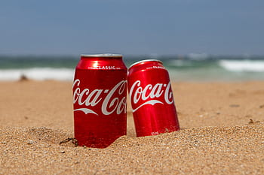
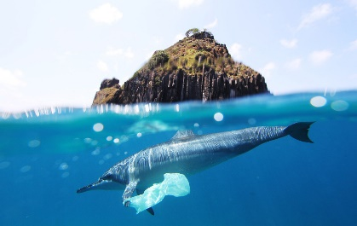
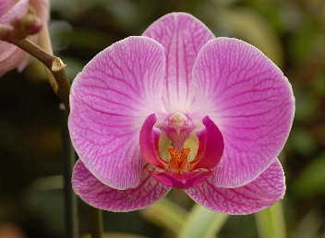
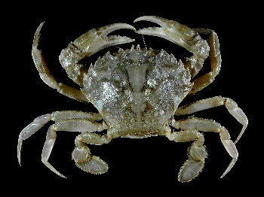
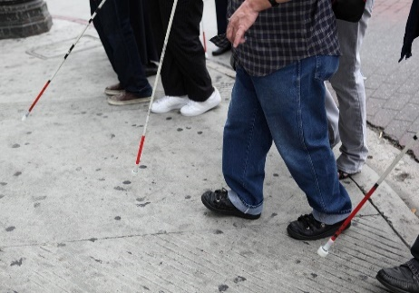
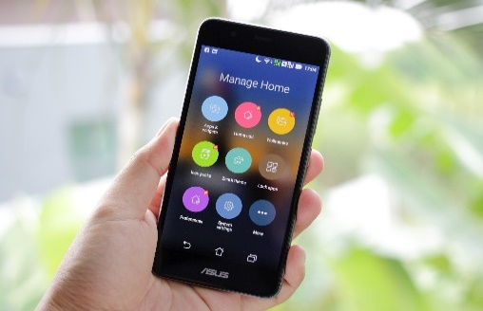
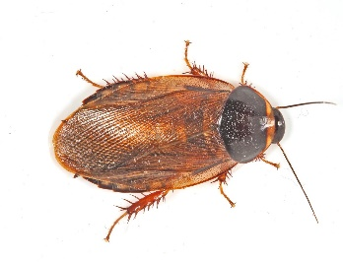
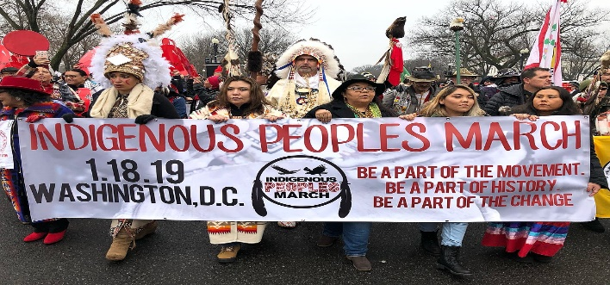
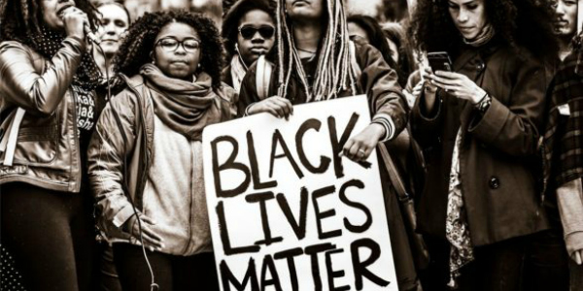
posthuman, beyond human

Slide 8
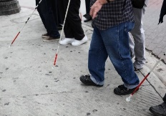

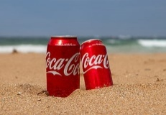


References linked to images:
Bateson, Gregory (1972). Steps to an ecology of mind. New York, NY: Ballantine Books.
Barad, Karen (2007). Meeting the universe halfway: quantum physics and the entanglement of matter and meaning. Durham, NC: Duke University Press.
Bennett, Jane (2010). Vibrant Matter: A Political Ecology of Things. Durham. Duke University Press
Braidotti, Rosi (2013). The Posthuman. London: Polity Press.
Wynter, Sylvia (1994). “No humans involved”. An Open Letter to My Colleagues. Knowledge on Trial, 1, 1, 42-73. https://bit.ly/33uP1VU

Slide 9
Worlding
“Finding where exactly the outside world ends and I begin—is not so easy.” (Nora Bateson, 2016)
“we are not only creatures…but creators. The world is always in the making” (Arne Naess, 2002)
We live in language and in a material world.
We act in and through relationships, in and through language and in and through matter
we are making material-discursive worlds as we move with and through environments, communities, conversations. (Salter and Simon, 2025)

Slide 10
Extending social
“Transmaterial worlding extends the notion of “social” in social construction to include human and non-human participants.”
It is a “reframe of social construction in emphasising the continuous process of intra-becoming within and between species and matter (Barad, 2007).” (Simon and Salter, 2019)
It is “motivated by a concern for ecological survival and “social” justice where social is reframed to include a consideration of all peoples and ecosystems.” (Simon and Salter, 2019)

Slide 11
Transmaterial Worlding as (part of) Therapy
The social/ relational world that is co-created in a therapy context includes more than the human actors in the seats and the ones we populate the room with. TW offers a way of conceptualising systems to re-position humans as part of a wider ecology, inclusive of other life forms and matter.

Slide 12
TW questions
EcoSystemic Practice
  What alternative stories can be found in nature that speak to non-binary expressions of living and relating?
  (How might therapists ask people wanting therapy) where would be most comfortable or safe in terms of familiar or novel environments for therapeutic talk?

Slide 13
TW questions
Social Justice
  Do families (you) have access to green spaces? Access to work, education and health care? Are these places safe for them (you)?
  How does the environment in which families (you) live tell its own story of injustice and resilience and demise?

Slide 14
TW questions
Ecological Context
  How might therapists and families (we) together map out the interconnectedness of human and non-human actors influencing things like the built environment, work possibilities, relationships, economy, pollution, and life choices? (extending genogram)
  If there were more locally relevant locations outside of the professional territory of the clinic or consulting room available to families (you), would they (and how would they/you) access them? (extending offer)

Slide 15
Justice doing
“The commitment in the psychotherapies to change-for-the-better with humans is flawed if just focusing on humans, given the transmaterial crises going on in our world. Our environmental, climatic, economic worlds are in free-fall, while structural inequalities continue to create a hierarchy of human life. It would be bizarre then for therapy to carry on as if the challenges to our socio-material worlds were incidental to our work as therapists, as if problems a person encounters were not connected to worldwide problems. The unit of the individual or small system is a western capitalist measure of production and reflects the western medical model of the individual body as the locus of illness.”
(Simon and Salter, 2020)

Slide 16
Pause and reflect
What questions does this raise for you, reflecting on your own practice (s)?

Slide 17
Relating with trees- Extending the frame
How it began – Taos event TW as one of 3 papers as stimuli
Simon and Salter (2019); Muraca “Relational values” (2016) Kurio and Reason (2021) “panpsychic research with rivers”
Rolla Lewis, Peter Whitehouse, Nelly Ndirangu, Yuki Minamii, Jeff Fifield, Leah Salter (California; Ohio; Kenya; Fukuoka, Japan; Guetemala; Wales)
How it evolved – over zoom – group to grove
What we learned from each other – learning to slow down (tree time) gender/ context
What we experienced for ourselves – profound transformation – Hemlock, not “the hemlock”, tree doctor to dragon, tree as central to brokering peace

Slide 18
Learning from Trees
“Think like a tree”
“The hidden life of trees”
“ The secret life of trees”
“The language of trees”
“The heartbeat of trees”
“Good Nature”
Speaking into and out of this learning

Slide 19
The role of stories
Larissa Berhrendt indigenous Australian film maker and storyteller :
Indigenous stories carry stories of land and landscape and stories of human injustice and the deep wounds of colonial pain. “Indigenous storytelling is circular” “we know that there are cycles, that there are high points and low points of our history. Just as the seasons go in cycles, just as our lives go in cycles, so too does our history as peoples.”
“the cities we inhabit now, the infrastructure that goes through our lands, the destructive activities that disrupt our ecosystems will one day be gone and the land will still be {our} land.” (Berhrendt, 2019)

Slide 20
Eco-relating
“co-becoming with country storys diverse communication and multiple languages, all intertwined into a tapestry of the cycle of life and death, of being in this world.”
Nerida Blair, 2019- Indigenous Australian researcher
“my wellbeing is caught up with your wellbeing”
Cathy Richardson, 2023 – substack (trees as partners/ all of our ancestors) and murmurations.cloud
Celtic stories – the interconnectedness of life (human and non-human life) animal and human shape-shifting being central to many of the storylines in Celtic mythology and oral storytelling traditions as well as transitioning between worlds and realms and crossing over (e.g. Pwll in the Mabinogion, or Oisín in the stories of the Fianna) (Mabinogion 1989, Lady Gregory 1994).
Trees as portals

Slide 21
Activity
Holding “your” tree in mind (or move outdoors to be with a tree for 7 minutes):
What stories do/would you tell about your tree?
What stories might your tree tell about you?
What stories might you and your tree tell about your relationship?
What did your tree/ encounter teach you?

Slide 22
A story to end…
Rhoda and me

Slide 23
Poem- The stillness
In the pulsing beat between
Land and sea
Sea and sky
Root and trunk
I breathe the deepest breaths
And find my heart's rhythm
Beating to be still
Still active
Still attuned
Still alert
To the mystery
That is infinitely too "everything"
For me to ever perceive
And yet notices me
And requests my presence
Here, now
And so, I drop down
Into the soil
At the feet of the great trees
And know I am alive

Slide 24
Read more about Transmaterial Worlding:
Simon, Gail & Salter, Leah (2019). “Transmaterial Worlding. Beyond Human Systems.” Murmurations: Journal of Transformative Systemic Practice, 2, 2, 1-17. https://doi.org/10.28963/2.2.2
Simon, Gail & Salter, Leah (2020). ”Transmaterial Worlding as Inquiry.” Chapter in The Sage Handbook of Social Construction. Eds. Mary Gergen, Sheila McNamee et al. London: Sage Publications.
Salter, Leah; Kebbe, Lisen & Simon, Gail (2021). “” Murmurations: Journal of Transformative Systemic Practice, 4(1), 48-73. https://doi.org/10.28963/4.1.5
Salter, Leah and Simon, Gail (2025) “Therapy as Tranmaterial Worlding” in Bava, S and Olga Smoliak, O Eds Routledge International Handbook of Postmodern Therapies. London : Routledge

Slide 25
And some other refs/ further reading
Barad, Karen (2007). Meeting the universe halfway: quantum physics and the entanglement of matter and meaning. Durham, NC: Duke University Press.
Bateson, Gregory (1972). Steps to an ecology of mind. New York, NY: Ballantine Books.
Bateson, Nora (2016). Small arcs of larger circles: Framing through other patterns. Dorset: Triarchy Press.
Braidotti, Rosi (2013). The Posthuman. London: Polity Press.
Bennett, Jane (2010). Vibrant Matter: A Political Ecology of Things. Durham. Duke University Press
Chen, Mel J. (2012). Animacies: Biopolitics, Racial Mattering, and Queer Affect. Durham. Duke University Press.
Edwards, Lorna; Breden, Andreas; Santin, Chiara; van Lawick, Justine & van der Elst, Erik (2022). Reclaiming the relationship with bodily knowing through movement in nature. Murmurations: Journal of Transformative Systemic Practice, 5(2), 138-151. https://doi.org/10.28963/5.2.10
Haraway, Donna J. (2016). Staying with the trouble: Making kin in the Chthulucene. Durham, NC: Duke University Press.
Jude, Julia (2017). African Indigenous oral traditional endarkened feminist practice: Indigenous knowledge on the wrong side of Matter. Murmurations: Journal of Transformative Systemic Practice, 1(1), 57–67. https://doi.org/10.28963/1.1.6

Slide 26
And some other refs/ further reading
Pillow, W. S. (2016). Data matters and data matterings: Slit theory, ontology white-outs, and archival afterlifes or the postman only rings twice in some neighborhoods: Who matters in new ontological discussions. Paper presented at the Annual Meeting on Qualitative Inquiry, University of Illinois at Urbana-Champaign.
Pillow, Wanda S. (2019a). Epistemic witnessing: theoretical responsibilities, decolonial attitude and lenticular futures. International Journal of Qualitative Studies in Education, 32(2), 118-135. https://doi.org/10.1080/09518398.2019.1576938
Shotter, John (2014). Agential realism, social constructionism, and our living relations to our surroundings: Sensing similarities rather than seeing patterns. Theory & Psychology, 24(3), 305-325. https://doi.org/10.1177/0959354313514144
Simon, Gail (2021). Panmorphic Crisis: Cultural Rupture and Systemic Change. Murmurations: Journal of Transformative Systemic Practice, 4(1), 87-101. https://doi.org/10.28963/4.1.7
Wynter, Sylvia (1994). “No humans involved”. An Open Letter to My Colleagues. Knowledge on Trial, 1, 1, 42-73. https://bit.ly/33uP1VU
Wynter, Sylvia (2006). On how we mistook the map for the territory, and reimprisoned ourselves in our unbearable wrongness of being, of Desêtre: Black Studies Toward the Human Project. In L.R. Gordon, & J. A. Gordon (Eds.), A Companion to African‐American Studies (pp. 107-118). https://doi.org/10.1002/9780470996645.ch9

Slide 27
Some ways to connect and speak up:
www.centreforsystemicstudies.co.uk
leahsalter@centreforsystemicstudies.co.uk
www.Murmurations.cloud
editors@murmurations.cloud

